Slide 1



Challenges and Hot Tips for Conducting
Multi-Site Group-Based Clinical Trials
March 6, 2025
Jacob D. Hill, ND, MS, FABNO, Narissa P. McCarty, MS, Elizabeth K. Seng, PhD, Rebecca E. Wells, MD, MPH, Natalia E. Morone, MD, Keturah Faurot, PhD, MPH, PA, Frederick M. Hecht, MD, Patricia J. Moran, PhD, Amanda J. Shallcross, ND, MPH

Slide 2
Disclosure
The authors of this presentation have no conflicts of interest to disclose.

Slide 3
Panel Discussion Outline
Review Learning Objectives
Introduction to panelists and their studies
Open discussion with question prompts
Panelist final thoughts and suggestions for future study teams
Question and answer session

Slide 4
Learning Objectives
Attendees should be able to explain why group-based multi-site clinical trials are important for the field of integrative medicine.
1
Attendees should be able to articulate examples of how and why a group-based intervention design increases the complexity of multi-site trials.
2
Attendees should be able to identify 3 strategies to prevent and/or overcome common challenges related to group-based multi-site clinical trials.
3

Slide 5



Panelists
Patty Moran, PhD
University of California San Francisco
Research Project Director
LEGEND Study
Amanda J. Shallcross, ND, MPH
Cleveland Clinic
Principal Investigator
TEAM-M Study
Natalia E. Morone, MD
Boston University
Principal Investigator
OPTIMUM Study

Slide 6

Treatment for Migraine and Mood
(TEAM-M)
  60% of people with migraine report elevated depressive symptoms
  Depressive symptoms are associated with, 1) higher migraine disability, 2) chronic opioid therapy for migraine pain, 3) doubled healthcare costs for migraine
  Scalable treatments that address migraine disability and depressive symptoms is a major gap in migraine treatment
  Brief Mindfulness-Based Cognitive Therapy (MBCT-Brief)
  MBCT targets pain perception, pain catastrophizing, and distress tolerance involved in the maintenance of chronic pain and depression

Slide 7


Treatment for Migraine and Mood
(TEAM-M)
N = 144
3 arm RCT
  MBCT-T (Telephone)
  MBCT-V (Videoconferencing)
  EUC (Enhanced Usual Care)
3 sites
  Cleveland Clinic
  Albert Einstein College of Medicine
  Atrium Health Wake Forest Baptist
Primary outcomes: fidelity, feasibility, acceptability, recruitment

Slide 8
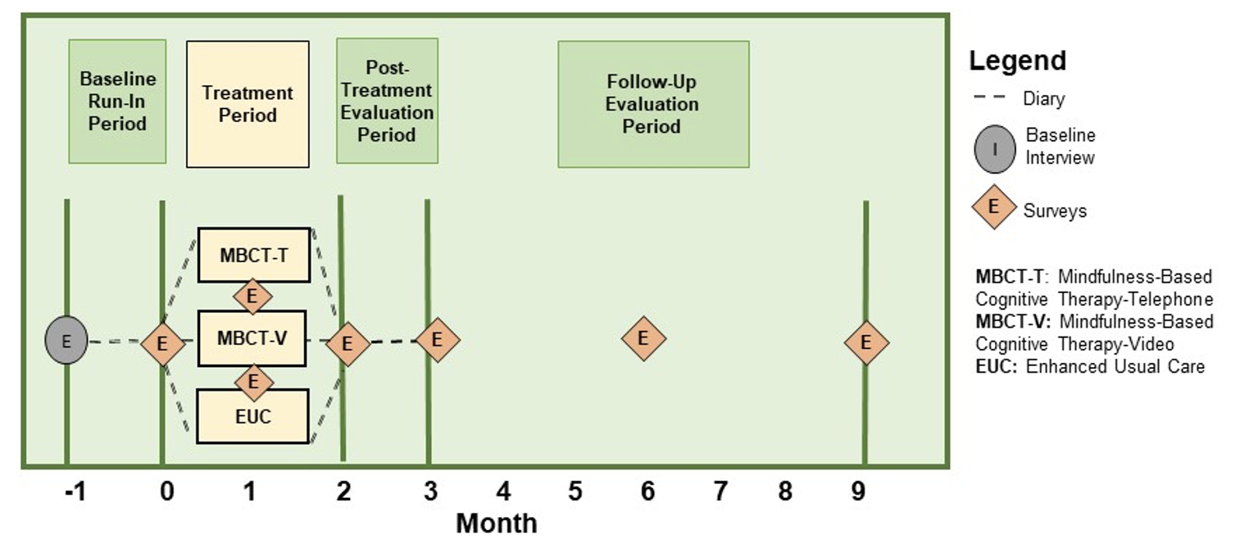
Treatment for Migraine and Mood
(TEAM-M)

Slide 9
The LEGEND Study:
Lifestyle Education about Nutrition for Diabetes
Type 2 diabetes is the most expensive chronic disease in the U.S.
Optimal carbohydrate intake is controversial in nutritional management
RCT comparing two diets for glycemic control in adults with type 2 diabetes
NIH grant R01DK126898, Laura Saslow PhD, PI, University of Michigan, Ann Arbor (UM); Rick Hecht, MD, Site PI, University of California, San Francisco (UCSF)
ClinicalTrials.gov NCT05237128

Slide 10


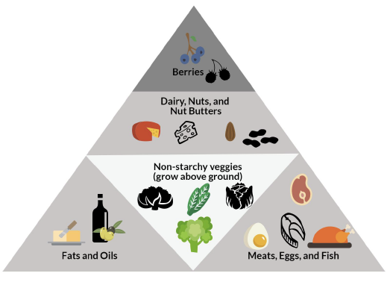

The LEGEND Study
Participants randomized to one of two 20-session group-based diet and lifestyle intervention for one year, delivered via Zoom.
Keto (very low-carbohydrate) versus My Plate (moderate-carbohydrate)
N=182 (target n=180) adults with type 2 diabetes (HbAlc 6.5-11.9%)
Two sites: UCSF (n77) and UM (n105)

Slide 11
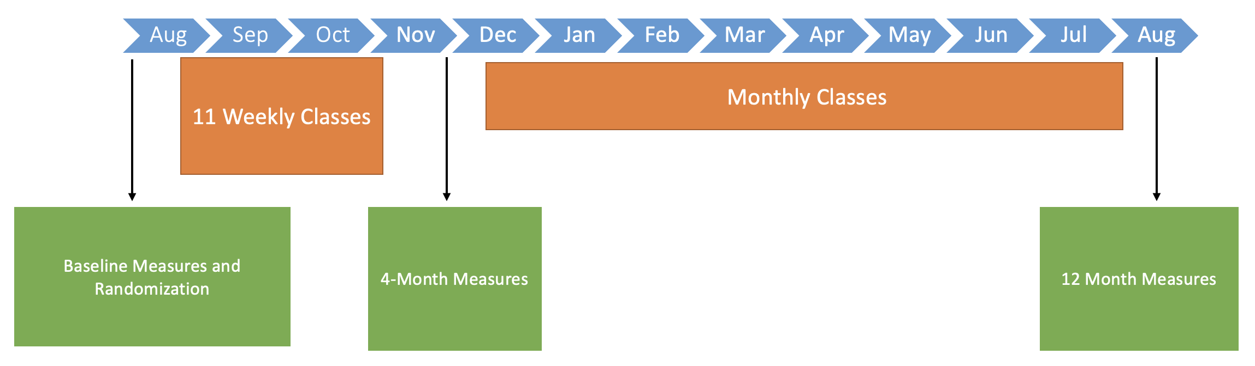
The LEGEND Study
Outcomes assessed at baseline, 4, & 12 months.
Primary outcome: HbA1c—average blood glucose levels over past 2-3 months.
Secondary outcomes include:
    Labs (LabCorp locations in CA and MI)
    DEXA scans (at UCSF and UM)
    Remotely-collected outcomes (body weight, diet intake/adherence, PROs)
High retention to date in study classes and assessments out to 12 months.

Slide 12

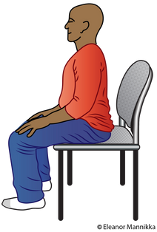


Optimizing Pain Treatment In Medical Settings Using Mindfulness (OPTIMUM)
A pragmatic clinical trial integrating a telehealth group-based
Summary
mindfulness stress reduction program into primary care settings for persons with chronic low back pain
Study design
Pragmatic randomized controlled trial
One year follow-up
Three healthcare systems: Boston Medical Center, Pittsburgh/UPMC, North Carolina
Control group
225 receive usual primary care
Population
450 patients with chronic low back pain ≥ 18 years of age
Intervention group
225 participate in 8-week Mindfulness Based Stress Reduction program
Comparison
Mindfulness vs Usual Care
Baseline
w8
m6
m12
Pain Intensity & Pain Interference (PEG, Primary Outcome)
Outcomes
Psychological function
Physical function Healthcare utilization
Pain medication/opioid use
Greco CM et al. The design and methods of the OPTIMUM study: A multisite pragmatic randomized clinical trial of a telehealth group mindfulness program for persons with chronic low back pain. Contemp Clin Trials. 2021

Slide 13
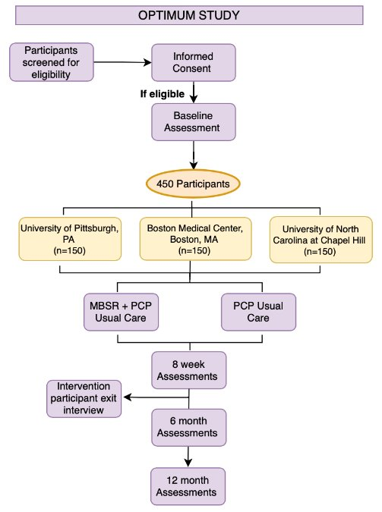
Optimizing Pain Treatment In Medical Settings Using Mindfulness (OPTIMUM)

Slide 14

Optimizing Pain Treatment In Medical Settings Using Mindfulness (OPTIMUM)
Patient signs into group Zoom with mindfulness instructor, primary care provider, and other patients
Patient meets with provider for brief check-in via breakout room
Patient returns to full group and participates in mindfulness program

Slide 15
Question Topic:
Recruitment and Intervention Delivery
What do you need to consider when coordinating recruitment and intervention delivery across sites?
Are there benefits to mixing participants from various sites into one intervention group vs. having site-specific groups?
How do you manage scheduling group intervention visits when participants and intervention facilitators may have differing schedules and availability?
How do you coordinate intervention delivery across sites in different time zones?

Slide 16
Question Topic:
Site Coordination/Management
5. What are helpful approaches to working with underperforming sites?

Slide 17
Question Topic:
Data Management
6. What are best practices for managing data collection and staffing across sites?
7. Is it best to use a single data management project (e.g., REDCap) for all sites, or have individual data collection projects at each site?

Slide 18
Question Topic:
Regulatory/IRB
8. What are the challenges with establishing the institutional review board (IRB) for multi-site group-based intervention studies? For example, should study teams submit their proposal to a third-party sIRB vs an sIRB at an academic institution?

Slide 19
Question Topic:
Regulatory/IRB
9. Do all sites need to have IRB approval if they have limited involvement and may not be conducting “research activities”?

Slide 20
Lessons Learned & Suggestions for Future Study Teams
TEAM-M STUDY
Understand each institutions policies and guidelines regarding data collection, how they vary, and work out in advance how you are going to comply with institutional guidelines to collect data in the most efficient way possible.
Think through the pros and cons of delineating across sites vs. within sites the recruitment process, from screening to consent to randomization (e.g., coordinate scheduling, streamline communication for participants).
Have a very clear understanding of your recruitment rate and whether it is feasible to run a multisite study where there are heterogeneous vs. homogenous groups across/within sites. Can you have groups that represent individuals at one site vs across sites?

Slide 21
Lessons Learned & Suggestions for Future Study Teams
LEGEND Study
Work as one team, as feasible.
Use a shared database and cross-train staff (with IRB approval) to work with participants at either site.
Consolidate some responsibilities under one site (time-consuming but participant payments, LabCorp).
Have a shared high-level/experienced project manager that meets weekly with staff at both sites and serves as key point person for staff to turn to for troubleshooting and handling problems day to day.
2. Use a study design that includes at least some elements (interventions, assessments) that you have previously tested or implemented.
3. Time differences between sites may complicate some things but may also offer benefits.
4. sIRB initial approvals can be complicated and time-consuming but tend to work more smoothly as the study progresses.

Slide 22
Lessons Learned & Suggestions for Future Study Teams
OPTIMUM Study
Flexibility is key in leading a multi-site group-based clinical trial as sites will be unique in their participant populations, recruitment strategies, and when they deliver the intervention.
Regular communication is key to keeping all trial sites and team members informed about the study as well as an opportunity to share barriers and approaches to resolving barriers as they arise.
Participant-centered approach to trial implementation enhances engagement and retention.
Engagement and retention also improve when patient reported outcomes and their purpose is described.
Many integrative interventions are group-based and rigorous study of them is critical to moving the field forward and translating group-based interventions into clinical practice.

Slide 23
Q&A Session
Audience: What questions do you have for our panelists?

